Slide 1





Course Name object oriented analysis and design
CSC 2210
(Undergraduate)
Software engineering (Undergraduate)
Chapter 9 software project estimation
Victor Stany Rozario
Assistant Professor
Department of Computer Science, AIUB
Web: https://cs.aiub.edu/profile/stany

Slide 2
Software measurement
OOAD : Software Project Estimation
Victor Stany Rozario
S.2
Software measurement is a quantified attribute of a characteristic of a software product or the software process (e.g., quality, complexity, etc.)
The ability to measure attributes of software and the software development process are essential to improvements in the practice of software engineering
Measurements enables us to evaluate the situation properly (objective evaluation).
It can also be applied to improve the software process and hence assist project management

Slide 3
Software metrics
OOAD : Software Project Estimation
Victor Stany Rozario
S.3
The common measurement entities are the software metrics, which helps us to evaluate:
Performance, Efficiency, Security, Complexity, Testability, Flexibility, etc.
Metric is a quantifiable measure (characteristic) of software, e.g., 2 errors were discovered by customers in 18 months (more meaningful than saying that 2 errors were found)

Slide 4
Software metrics : size
OOAD : Software Project Estimation
Victor Stany Rozario
S.4
Measuring the size of a program is by counting the number of lines of code (LOC)
During maintenance, the focus is on number of lines of code that have been added or modified during a maintenance process.
Easy to determine and also correlates strongly with other measures such as effort and error density.

Slide 5
Software metrics : complexity
OOAD : Software Project Estimation
Victor Stany Rozario
S.5
One of the major problems that software maintainers face is dealing with the increasing complexity of the source code that they have to modify (Cyclomatic code complexity).
Includes program structure, semantic content, control flow, data flow, and algorithmic complexity.
The more complex a program is, the more likely it is for the maintainer to make an error when implementing a change.
The higher the complexity value, the more difficult it is to understand the program, hence making it less maintainable.

Slide 6
Software measures
OOAD : Software Project Estimation
Victor Stany Rozario
S.6
Cyclomatic code complexity (CCC)
Weighted Methods per Class (WMC)
Depth of Inheritance Tree (DIT)
Number of Children (NOC)
Coupling between Classes (CBC)
Lack of Cohesion in Methods (LCOM)
COCOMO

Slide 7
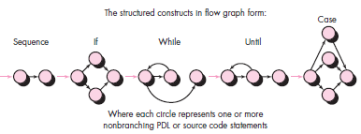
OOAD : Software Project Estimation
Victor Stany Rozario
S.7
McCabe's Cyclomatic Complexity
McCabe views a program as a directed graph in which lines of program statements are represented by nodes and the flow of control between the statements is represented by the edges.

Slide 8
Independent program paths
OOAD : Software Project Estimation
Victor Stany Rozario
S.8
Path 1: 1-11
Path 2: 1-2-3-4-5-10-1-11
Path 3: 1-2-3-6-8-9-10-1-11
Path 4: 1-2-3-6-7-9-10-1-11
Note that each new path introduces a new edge. The path 1-2-3-4-5-10-1-2-3-6-8-9-10-1-11 is not considered to be an independent path because it is simply a combination of already specified paths and does not traverse any new edges.
How do you know how many paths to look for? The computation of cyclomatic complexity provides the answer.

Slide 9
OOAD : Software Project Estimation
Victor Stany Rozario
S.9
McCabe's Cyclomatic Complexity
Cyclomatic complexity is a software metric that provides a quantitative measure of the logical complexity of a program. Complexity is computed in one of four ways:
The number of independent path.
The number of regions of the flow graph corresponds to the cyclomatic complexity. (in the previous example = 4)
Cyclomatic complexity V(G) for a flow graph G is defined as V(G) = E - N + 2 (in the previous example 11 -9 + 2 = 4)
where E is the number of flow graph edges and N is the number of flow graph nodes.
Cyclomatic complexity V(G) for a flow graph G is also defined as V(G) = P + 1 (in the previous example 3 + 1 = 4) [condition: 1 - 2,3 - 6]
where P is the number of predicate nodes (containing a condition) contained in the flow graph G.

Slide 10
McCabe's Cyclomatic Complexity
OOAD : Software Project Estimation
Victor Stany Rozario
S.10
Used as an indicator of the psychological complexity of a program.
During maintenance, a program with a very high cyclomatic number (usually above 10) is considered to be very complex.
It helps to identify highly complex programs that may need to be modified in order to reduce complexity.
The cyclomatic number can be used as an estimate of the amount of time required to understand and modify a program.
The flow graph generated can be used to identify the possible test paths during testing.

Slide 11
McCabe's Cyclomatic Complexity
OOAD : Software Project Estimation
Victor Stany Rozario
S.11
It takes no account of the complexity of the conditions in a program
In its original form, it failed to take account of the degree of nesting in a program.
Cyclomatic complexity Threshold Values | Risk evaluation
01 – 10 | Simple Program, without much risk
11 – 20 | More complex program, moderate risk
21 – 50 | Complex program, high risk
> 50 | Un-testable program, very high risk

Slide 12
Weighted methods Per class (WMC)
OOAD : Software Project Estimation
Victor Stany Rozario
S.12
The effort in developing a class will in some sense will be determined by the number of methods the class has and the complexity of the methods.
Suppose a class C has methods M1, M2... Mn defined on it. Let the complexity of the method M1 be c1, then
WMC =
If the complexity of each method is considered 1, WMC will be (gives) the total number of methods in the class.

Slide 13
Weighted methods Per class (WMC)
OOAD : Software Project Estimation
Victor Stany Rozario
S.13
The data based on evaluation of some existing programs, shows that in most cases, the classes tend to have only a small number of methods, implying that most classes are simple and provide some specific operations
WMC metric has a reasonable correlation with fault-proneness of a class. As can be expected, the larger the WMC of a class the better the chances that the class is fault-prone
Number of Complex Methods in a class | Effect
High | - Potentially Error Prone - Impact on the children of the class - Reusability decreases
Low | - Reusability Increases

Slide 14
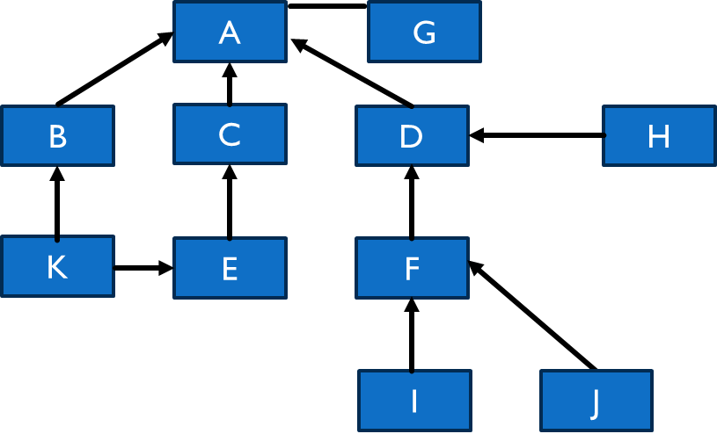
Depth of inheritance tree (DIT)
OOAD : Software Project Estimation
Victor Stany Rozario
S.14
The DIT of a class C in an inheritance hierarchy is the depth from the root class in the inheritance tree
Also, one of the main mechanisms for reuse
The deeper a particular class is in a class hierarchy, the more methods it has available for reuse, thereby providing a larger reuse potential
Inheritance increases coupling, which makes changing a class harder
A class deep in the hierarchy has a lot of methods it can inherit, which makes it difficult to predict its behavior

Slide 15
Depth of inheritance tree (DIT)
A
G
B
C
D
H
K
E
F
I
J

Slide 16
Depth of inheritance tree (DIT)
OOAD : Software Project Estimation
Victor Stany Rozario
S.16
It is the length of the path from the root of the tree to the node representing C or the number of ancestors C has
In case of multiple inheritance, the DIT metric is the maximum length from a root to C
Statistical data suggests that most classes in applications tend to be close to the root, with the maximum DIT metric value being around 10
Most the classes have a DIT of 0 (that is, they are the root)
The designers tend to keep the number of inheritance levels in the inheritance tree small, presumably to aid understanding. In other words, designers might be giving upon reusability in favor of comprehensibility

Slide 17
Depth of inheritance tree (DIT)
OOAD : Software Project Estimation
Victor Stany Rozario
S.17
The experiments show that DIT is very significant in predicting defect-proneness of a class: the higher the DIT the higher is the probability that the class is defect-prone
Attribute | Increase ( ↑ ) / Decrease ( ↓ ) Along with increasing DIT
Maintainability | ↓
Portability | ↓
Functionality | ↑
Efficiency | ↓

Slide 18
Number of children (NOC)
OOAD : Software Project Estimation
Victor Stany Rozario
S.18
The number of children (NOC) metric value of a class C is the number of immediate subclasses of C
This metric can be used to evaluate the degree of reuse, as a higher NOC number reflects reuse of the definitions in the superclass by a larger number of subclasses
It also gives an idea of the direct influence of a class on other elements of a design
The larger the influence of a class, the more important the class is correctly designed
In the empirical observations, it was found that classes generally had a small NOC metric value, with a vast majority of classes having no children
This suggests that in the systems analyzed, inheritance was not used very heavily
The data suggest that the larger the NOC, the lower the probability of detecting defects in a class

Slide 19
Number of children (NOC)
A
G
B
C
D
H
K
E
F
I
J

Slide 20
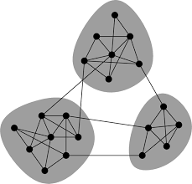

Coupling between classes (CBC)
OOAD : Software Project Estimation
Victor Stany Rozario
S.20
Coupling between classes of a system reduces modularity and make class modification harder
It is desirable to reduce the coupling between classes
The less coupling of a class with other classes, the more independent the class, and more easily modifiable
Coupling between classes (CBC) is a metric that tries to quantify coupling that exists between classes
The CBC value for a class C is the total number of other classes to which the class is coupled
Two classes are considered coupled if methods of one class use methods or instance variables defined in the other class (inheritance)

Slide 21
Coupling between classes (CBC)
OOAD : Software Project Estimation
Victor Stany Rozario
S.21
There are indirect forms of coupling (through pointers, etc.) that are hard to identify
The experimental data indicates that most of the classes are self-contained and have low CBC value
Some types of classes, for example, the ones that deal with managing interfaces, generally tend to have higher CBC values
The data found that CBC is significant in predicting the fault-proneness of classes, particularly those that deal with user interfaces
CBC Nominal Range | Analysis
0 | a class has no relationship to any other class in the system, not a part of the system
1 – 4 | Good, the class is loosely coupled
> 4 | the class is too tightly coupled, complicated testing and modification, and limited re-use possibilities.

Slide 22
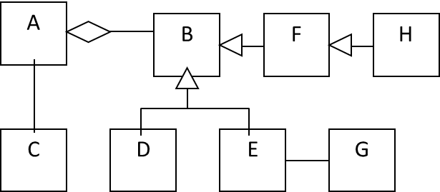
Example (NOC, DIT, CBC)
OOAD : Software Project Estimation
Victor Stany Rozario
S.22
CLASS | NOC | Influence on Design | DIT | Reuse Potential | CBC
A | 0 | Low | 0 | Low | Low
B | 3 | Highest | 0 | Low | Highest
C | 0 | Low | 0 | Low | Lowest
D | 0 | Low | 1 | Moderate | Low
E | 0 | Low | 1 | Moderate | Moderate
F | 1 | Moderate | 1 | Moderate | Moderate
G | 0 | Low | 0 | Low | Lowest
H | 0 | Low | 2 | Highest | Lowest

Slide 23
Lack of cohesion in methods (lcom)
OOAD : Software Project Estimation
Victor Stany Rozario
S.23
Cohesion captures how closely bound the different methods of the class are
Two methods of a class C can be considered “cohesive” if the set of instance variables (class variable) of C that they access, have some elements in common
Let I_{i} and I_{j} be the set of instance variables accessed by the methods M₁ and M₂, Q be the set of all cohesive pairs of methods, that is, all (M_{i}, M_{j}) such that I_{i} and I_{j} have a non-null intersection. Let P be the set of all non-cohesive pairs of methods, that is, pairs such that the intersection of sets of instance variables they access is null. Then LCOM is defined as
LCOM = |P|-|Q|, if |P| > |Q|, otherwise 0
Coupling (increase) → Cohesion (decrease) → LCOM (increase)

Slide 24
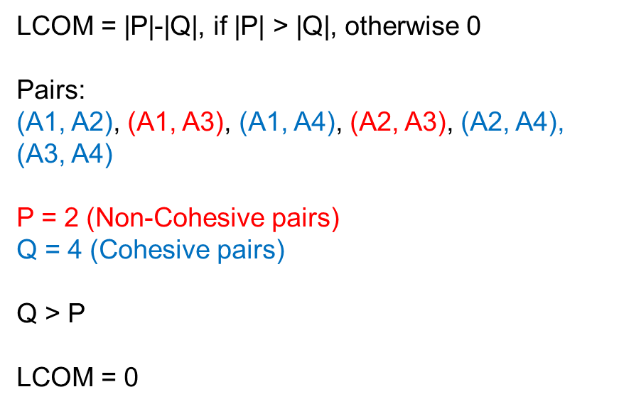
Example (LCOM)
OOAD : Software Project Estimation
Victor Stany Rozario
S.24
CLASS A
a1
a2
a3
a4
A1(a1, a2)
A2(a1)
A3 (a4)
A4 (a1, a4)

Slide 25
Lack of cohesion in methods (lcom)
OOAD : Software Project Estimation
Victor Stany Rozario
S.25
If there are n methods in a class C, then there are n(n-1) pairs, and LCOM is the number of pairs that are non-cohesive minus the number of pairs that are cohesive
The larger the number of cohesive methods, the more cohesive the class will be, and the LCOM metric will be lower
A high LCOM value may indicate that the methods are trying to do different things and operate on different data entities
If this is validated, the class can be partitioned into different classes
High cohesion & low LCOM is a highly desirable property for modularity.
There is little significance of this metric in predicting the fault-proneness of a class

Slide 26
COCOMO (Constructive Cost Model)
OOAD : Software Project Estimation
Victor Stany Rozario
S.26
Based on SLOC characteristic, and operates according to the following equations:
Effort = PM = Coefficient_{<Effort Factor>}*(SLOC/1000)^P [100,000 SLOC/1000 = 100k SLOC]
Development time = DM = 2.50*(PM)^T
Required number of people = ST = PM/DM
PM : person-months needed for project (labor working hours) SLOC : source lines of code P : project complexity (1.04-1.24) DM : duration time in months for project (weekdays) T : SLOC-dependent coefficient (0.32-0.38) ST : average staffing necessary
Software Project Type | Coefficient _{<Effort Factor>} | P | T
Organic | 2.4 | 1.05 | 0.38
Semi-detached | 3.0 | 1.12 | 0.35
Embedded | 3.6 | 1.20 | 0.32

Slide 27
COCOMO (Constructive Cost Model)
OOAD : Software Project Estimation
Victor Stany Rozario
S.27
Organic:
relatively small size (2-50 KLoc), simple, less innovative software projects in which a small teams with good application experience work to a project with less tightly schedule
Example: showing VUES information to webpage, payroll system
Semidetached:
Medium size (50-300 KLoc) and innovation, complexity in software project in which teams with mixed experience levels works in a mix of h/w and s/w application with relative tight schedule
Example: biometric log-in time saved in VUES database
Embedded:
A Large size (>300 KLoc), more innovative, complex software project that must be developed within a strongly coupled to hardware environment (e.g. Autopilot, biometric device, elevator)
Projects has the characteristics that the product being developed had to operate within very tight constraints and changes to the system are very costly

Slide 28
references
OOAD : Software Project Estimation
Victor Stany Rozario
S.28
R.S. Pressman & Associates, Inc (2010). Software Engineering: A Practitioner’s Approach.

